Slide 1
Cooperative Object Tracking for Improved World Modeling in Multi Agent Systems
William Kennedy
Nicholas Alton

Slide 2
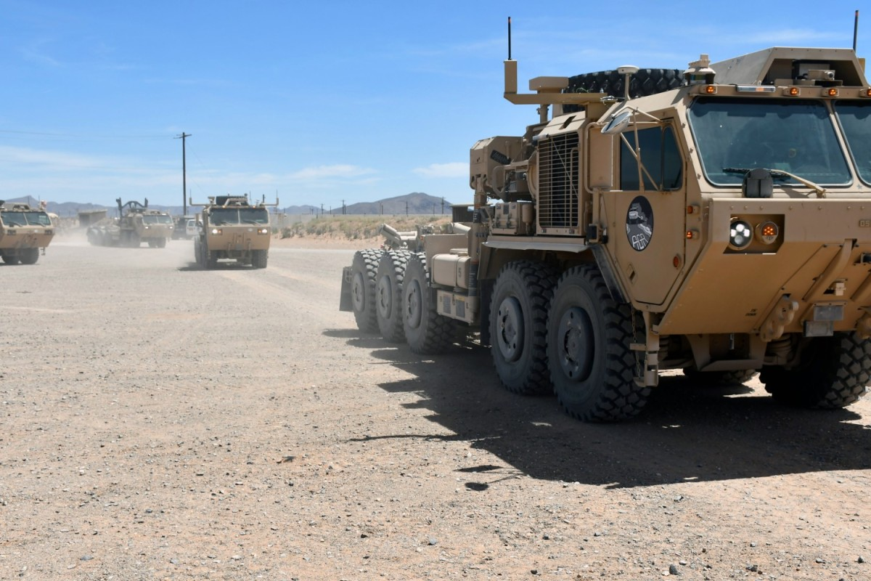
Background and Motivation
Increasing opportunities for robots to cooperate
Autonomous convoys
  Robotic formations
  Cooperative mapping or scouting
  Distributed sensing
  Swarm behaviors
Key challenges
  Communications – bandwidth, latency
  Scalability – compute limitations, communication limitations
Goal: develop a decentralized cooperative object-tracking system
  Allow cooperating robots or sensors to share object data
  Leverage open-source tracking algorithm for data association
  Share object-level data to conserve communication bandwidth
https://www.army.mil/article/259621/autonomous_vehicles_new_technology_revolutionizes_armys_principles_of_sustainment
Autonomous Vehicles: New Technology Revolutionizes Army's Principles of Sustainment

Slide 3
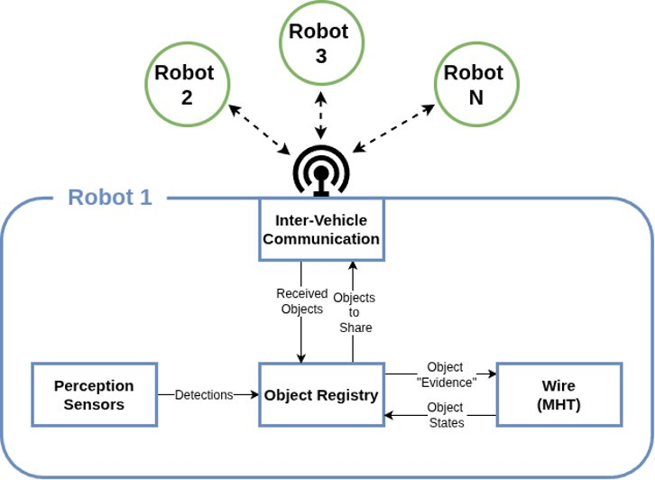
System Architecture
Decentralized – each robot maintains its own world model
  Perception data is fed into an object tracking node
Wire software package¹ is used for data association
Tracked objects are filtered and shared with cooperating robots
  Shared information is transmitted over radio network
  Object-level data shared rather than raw sensor data to conserve bandwidth
(1) https://github.com/tue-robotics/wire

Slide 4
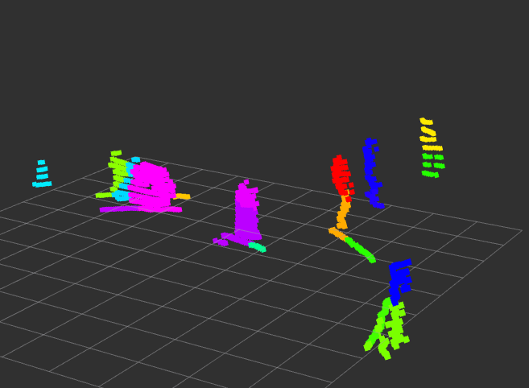
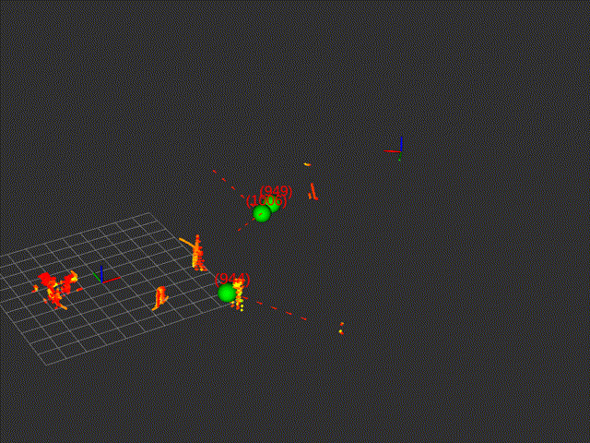
Object Detection and Tracking
Detection
  System set up to handle detections from arbitrary sensors
  For results shown today, lidars were used, coupled with a Euclidian clustering algorithm to isolate objects
  Focus was dynamic objects – static objects filtered out
Tracking
  Open-source tracking algorithm, Wire, used for data association and trajectory prediction
    ROS-based
    Multiple hypothesis tracking (MHT)
      Maintains many hypotheses on state of world model. Most probable is chosen as current state.
      Handles cluttered environments and intersecting trajectories

Slide 5
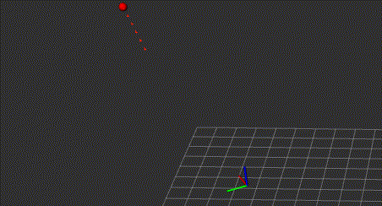
Inter-Robot Communications
Communication method
    Detection data sent using UDP over radio network
Discovery Messages
    Robots publish discovery messages
      Position
      Velocity
      IP
    When a new robot is discovered, it is added to a registry of cooperating robots
Detection messages
    Robots share object data describing relevant detections
      Position
      Velocity
      Classification
Serialization
    Detection data serialized using Cista¹
      ROS agnostic, C++ based serialization library
Red dots – detections received from other robots
Blue dots – detections from robot's own sensors
(1) https://github.com/felixguendling/cista

Slide 6
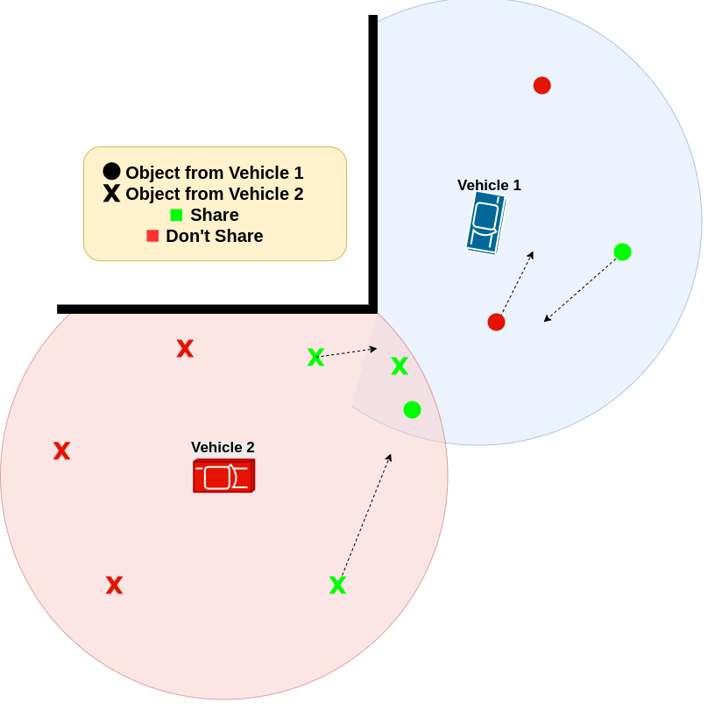
Shared Object Filtering
Detections filtered before sharing
Conserves bandwidth by only sharing relevant objects
Positions of each robot in registry propagated forward
Relevant objects determined based on current and predicted proximity
Filtering can be altered depending on environment and goal

Slide 7
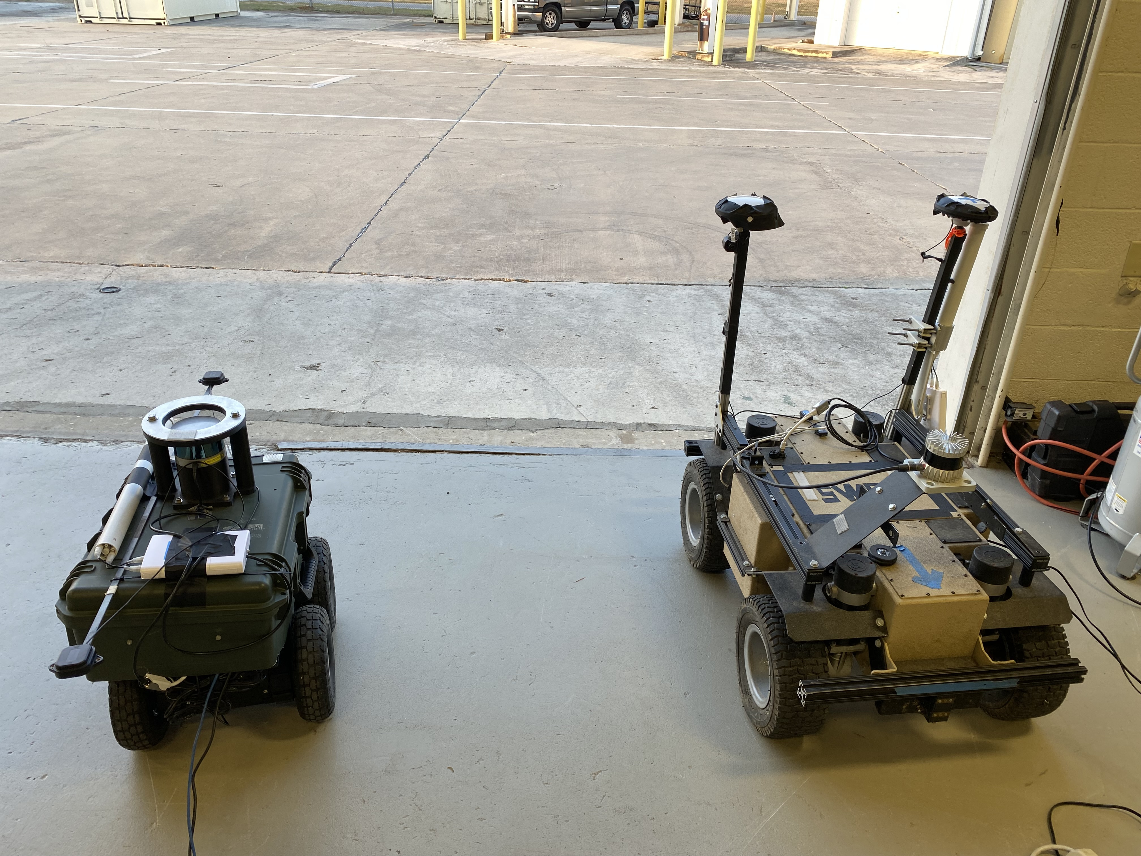
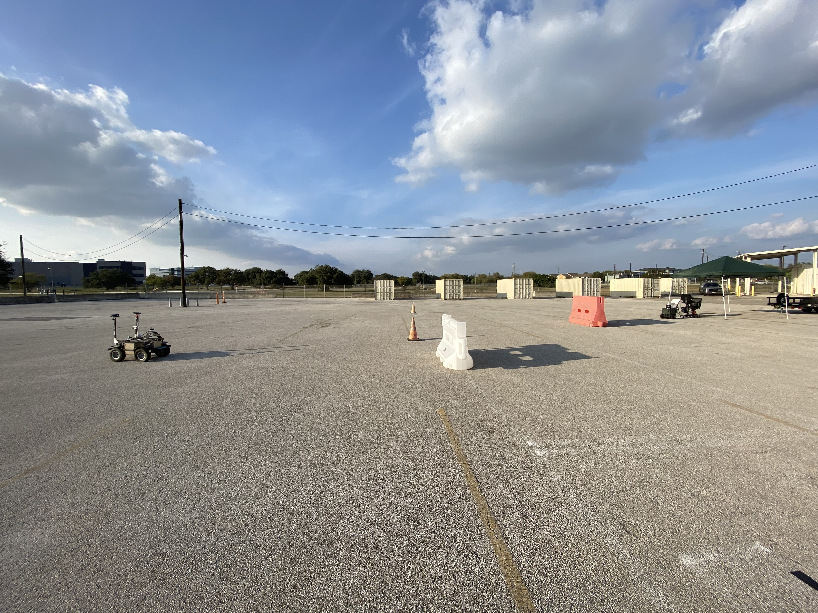
Test Setup
System deployed on two small mobile robots
Various obstacles and occlusions arranged throughout test area
Multiple tests conducted
  Varied the paths and types of objects tracked
Robots attempted to track pedestrians and a vehicle moving through the test area
Sensors
  Spar (right) – Ouster OS1 64-plane lidar
  Rover (left) – Velodyne 32-plane lidar

Slide 8
Tracking Accuracy
Robot | Vehicle tracking error (mean, max) | Pedestrian tracking error (mean, max)
SPAR | 1.3 m, 2.7 m | 0.4 m, 1.1 m
Rover | 1.2 m, 3.1 m | 0.2 m, 0.63 m
Two tests run; one with car and one with single pedestrian
The two robots attempted to track the objects
Accuracy calculated using GPS
System tracked pedestrian with lower error
  Likely due to size and geometry of car – lidars only detected one side, so centroid estimation was less accurate compared to pedestrian

Slide 9
Multi-object Tracking
Robot | % Time all objects tracked (no sharing) | % Time all objects tracked (sharing)
SPAR | 37.6% | 81.7%
Rover | 30.7% | 87.6%
Environment set up using jersey barriers and cones to mimic cluttered, occluded environment
Three pedestrians walked in various patterns throughout the test area

Slide 10
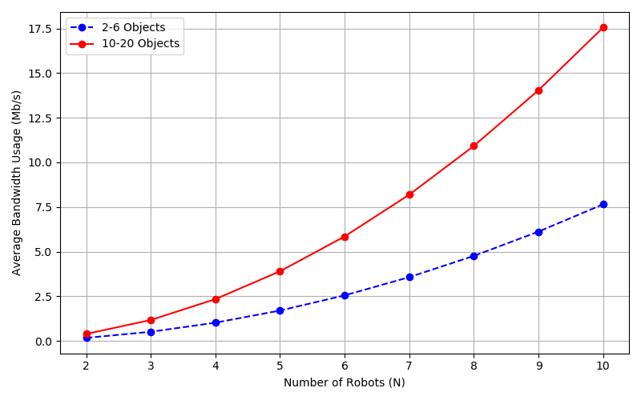
Communication Bandwidth
Communication bandwidth measured for both high-clutter (red) and low-clutter (blue) environments
Measurements from 2-robot testing extrapolated to larger groups
Bandwidth usage scales quadratically
Bandwidth vs. Number of Cooperating Robots

Slide 11
Future Work
Add cooperative localization
    Allow cooperating robots to register off shared objects/world model to align their frames
    Would lead to more accurate tracking
Encrypted communications and secure handshake/discovery
Expanded testing (larger groups, different environments)
Additional sensor modalities (cameras)

Slide 12
Questions?
Contact Info
william.kennedy@swri.org
210-522-6241

